Slide 1
Programlama, Robotik ve Oyun Geliştirme
Isınma Oyunu

Slide 2
Bilgi İşlemsel Düşünme
Disiplinlerarasılık
Programlama Becerileri
5 Zemin
Yaşam Becerileri
Robotik ve Oyun Tasarımı

Slide 3
Neden programlama becerilerini geliştirmek istiyoruz?
Notes:
Benefits of programming education--Artificial intelligence-Autonomous vehicles-
Programming skills are very important in the future roles of the students we will train. This is the vision of the world now. When we think about the professions that children will do when they grow up, robotics and programming technologies will be integrated into medicine, law and many professions. New professions will emerge.
Students can continuously use these tools at school and improve their digital literacy.
It can increase imagination and creativity.
It provides both result and process oriented thinking.
Their motivation to school and lessons can be increased and they lead to research
Internalizes knowledge with long-term memory use.
students with problem solving , spatial thinking and analytical thinking skills.
It enables them to acquire the habit of making large projects for the product and producing solutions to complex problems with the integration of small projects.
Collaborative work, learning skills, learning by doing and learning by teaching habits and culture can be developed.
Programming education can be started at an early age and programming education can be given at all levels. (Gulbahar,2017)

Slide 4
Kodlama mı programlama mı?
Kodlama
Kodlama, bilgisayar tabanlı bir görevin cihaz tarafından gerçekleştirilmesini amaçlayan kod yazma işidir.
Programlama
Programlama,
kodlama sürecinin teknik özellikleri ile birlikte tüm tasarım süreçlerini kapsayan yazılım üretiminin genel adımlarına verilen isimdir.
Notes:
While coding is a small part of programming, programming is the general name of software production steps that covers all design processes.
EXAMPLE: The robots we use for cleaning at home. It memorizes the square meter of the house and performs the sweeping operation. Program software is required for this.
While coding the block at Scharch, we can request the software of the program in a text-based program.

Slide 5
Kodlama Öğretimi
Kağıt etkinlikleri
Aktiviteler
Donanımlar

Slide 6
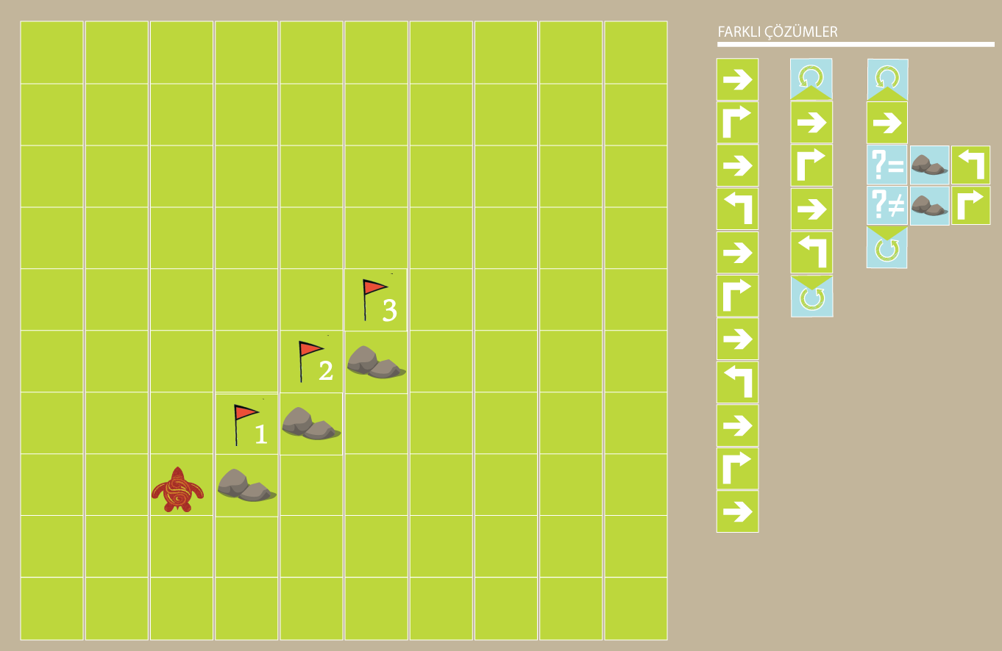
Kodlama Öğretimi
Kağıt
etkinlikleri

Slide 7
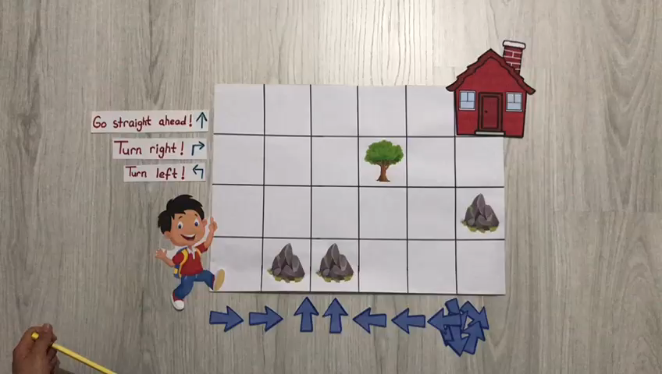
5. Sınıf İngilizce Dersi – Benim Kasabam / (Bilgisayarsız) Kodlama Etkinliği

Slide 8
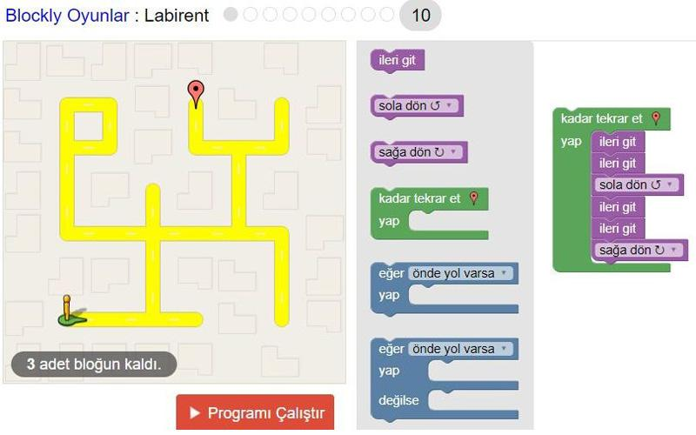
BİD VE PROGRAMLAMA
Soyutlama
Ayrıştırma
Örüntü Tanıma
Algoritma Tasarımı
Değerlendirme
Mantık

Slide 9
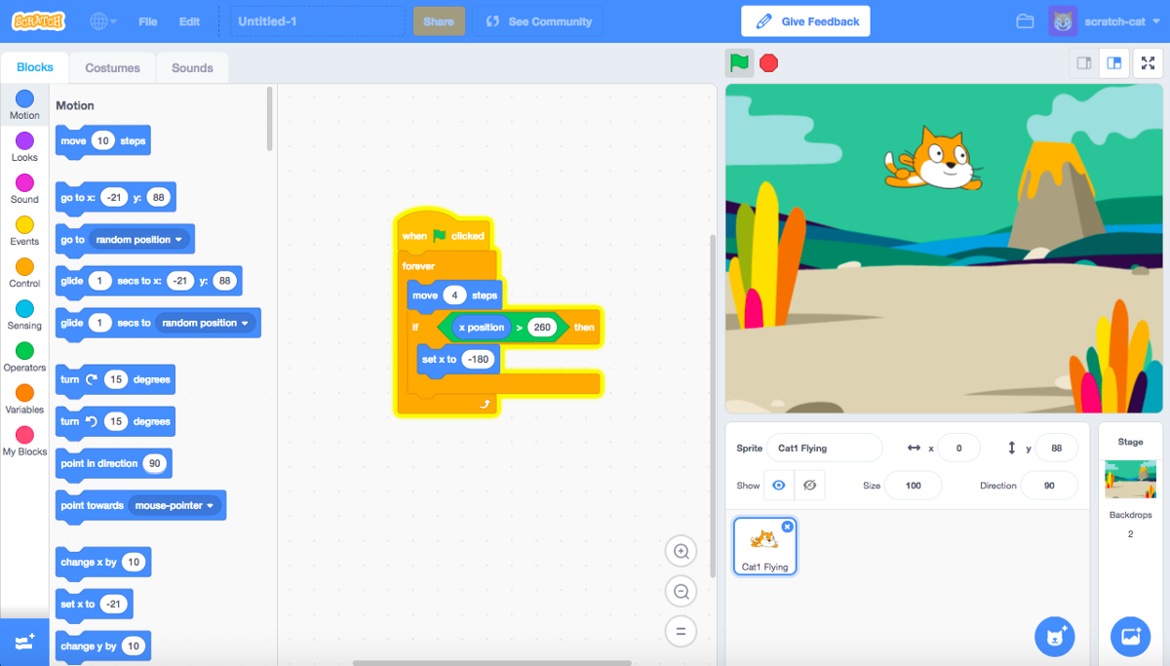
Oyun Yapalım
Basit hızlı bir sepete kelime toplama oyunu hazırlama

Slide 10
Oyun Yapalım
Soyutlama
Ayrıştırma
Örüntü Tanıma
Algoritma Tasarımı
Değerlendirme
Mantık

Slide 11
Sıra Sizde
Probleminize çözüm olarak seçtiğiniz konuyla ilgili imkanınıza göre
- kağıt oyunu,
- m block oyunu tasarla problemine adapte et, yükle

Slide 12
Robotik
Notes:
Programlama eğitiminin faydaları-Yapay zeka-Otonom araçlar-
Yetiştireceğimiz öğrencilerin gelecekteki rollerinde programlama becerileri çok önemlidir. Artık dünyanın vizyonu bu. Çocukların büyüyünce yapacakları meslekleri düşündüğümüzde robotik ve programlama teknolojileri tıp, hukuk ve birçok mesleğe entegre olacak. Yeni meslekler ortaya çıkacak.
Öğrenciler bu araçları okulda sürekli olarak kullanabilir ve dijital okuryazarlıklarını geliştirebilirler.
Hayal gücünü ve yaratıcılığı artırabilir.
Hem sonuç hem de süreç odaklı düşünmeyi sağlar.
Okula ve derslere olan motivasyonları artırılabilir ve araştırmaya yönlendirilebilir.
Uzun süreli hafıza kullanımıyla bilgiyi içselleştirir.
problem çözme, mekansal düşünme ve analitik düşünme becerilerine sahip öğrenciler.
Ürüne yönelik büyük projeler yapma ve küçük projelerin entegrasyonu ile karmaşık sorunlara çözüm üretme alışkanlığı kazanmalarını sağlar.
İşbirlikçi çalışma, öğrenme becerileri, yaparak öğrenme, öğreterek öğrenme alışkanlıkları ve kültürü geliştirilebilir.
Programlama eğitimine küçük yaşlarda başlanıp her seviyede programlama eğitimi verilebilmektedir. (Gülbahar,2017)

Slide 13
Robotik Öğretme
Tasarım çalışmaları
Bilgisayarsız Bilgisayar Bilimi Etkinlikleri
Sanal ve Gerçek Mikrokontrolcüler

Slide 14
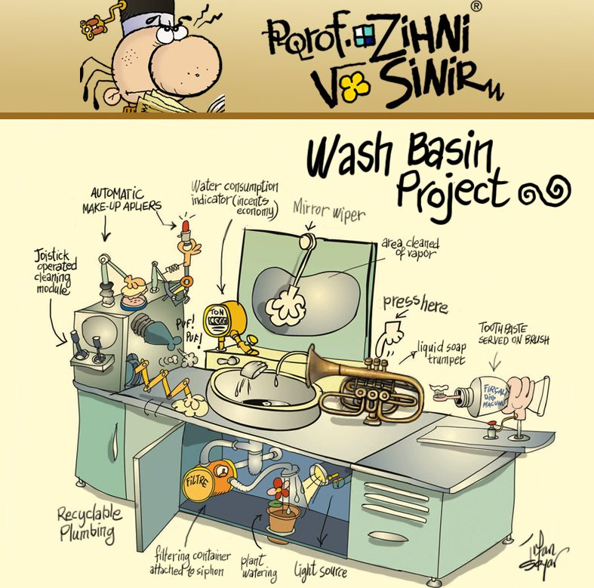
Tasarım olarak

Slide 15
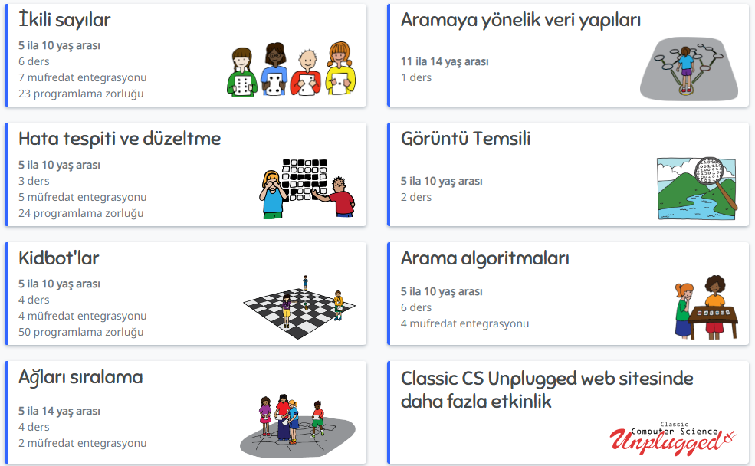
Bilgisayarsız Bilgisayar Bilimi
https://www.csunplugged.org/en/topics/

Slide 16
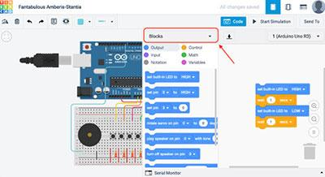
Tinkercad ile Robotik
Hesap Açma
Arayüz Tanıma
Kısa bir proje hazırlama

Slide 17
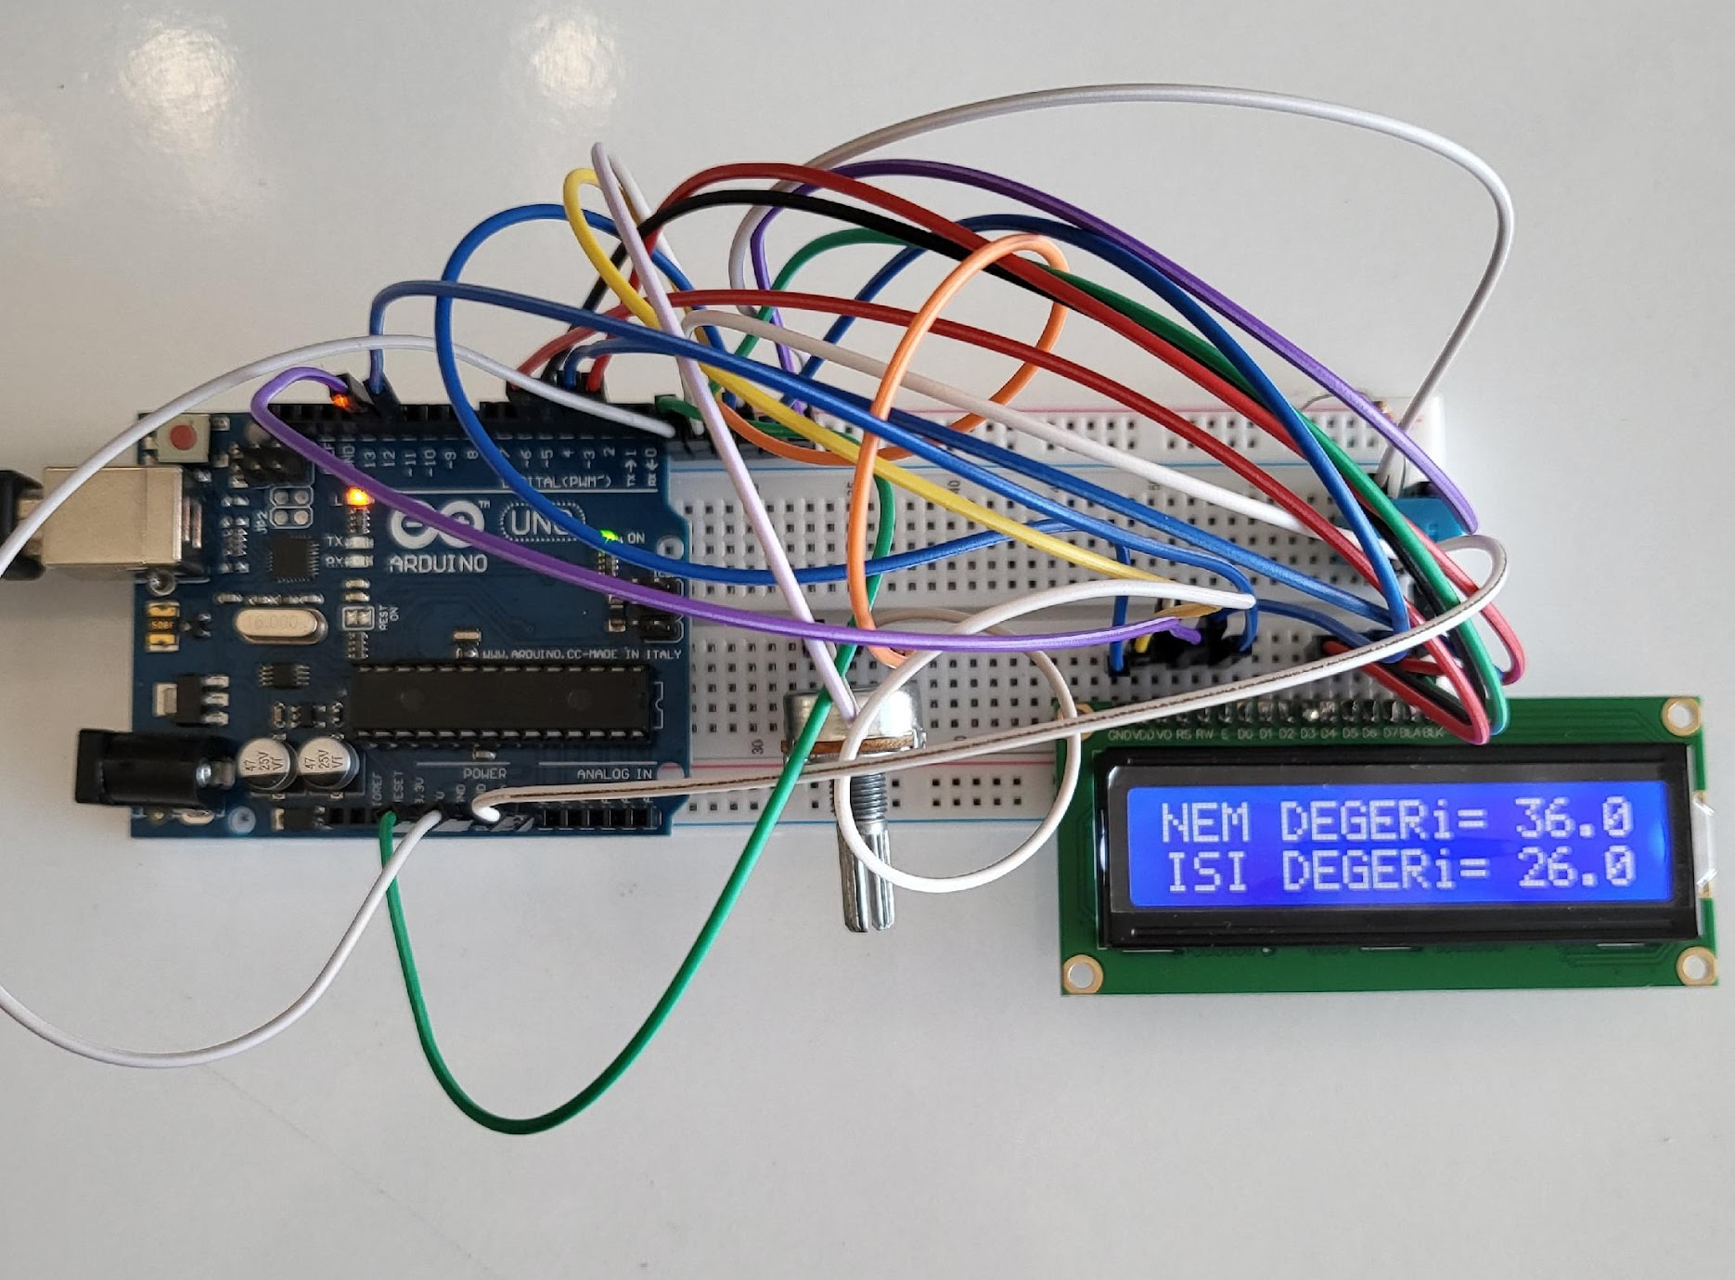
Fiziki Arduino ile Basit Proje Hazırlama

Slide 18
Sıra Sizde
Probleminize arduino yapılabilecek bir çözüm geliştirme. Padlete yükleme.
Soyutlama
Ayrıştırma
Örüntü Tanıma
Algoritma Tasarımı
Değerlendirme
Mantık
Projende hedefin ne:
Hangi sensörlere ihtiyacın var:
Hangi parçalara ihtiyacın var:
Nasıl iş bölümü yapacaksın:
Neleri öğreneceksin:
Hangi sıralamalarla yapacaksın:

Slide 19
Robotik Tasarım Örnekleri
Tasarım : Su tasarrufu sağlayacak bir toprak nemi ölçer tasarlamak
Tasarım : Uzaya gönderilen araçların atmosferdeki sürtünmeye en az maruz kalabilmesi için sürtünmeden etkilenecek robotik tasarım yapmak.
Tasarım : Organik atık bidonunun doluluk oranını ölçecek robotik tasarım yapılması

Slide 20
Proje Kaynakları
https://www.hackster.io/
https://www.instructables.com/
https://www.tinkercad.com/

Slide 21
Oyun Tasarımı
Oyun Dinamikleri
Ödül
Statü
Başarı
Özveri
Rekabet
Kendini ifade
Notes:
elements of game design and gamification; Competing to be successful, reaching prizes, power, point level with tools that leave an impact, providing a flow experience, making you want to play more. The most important feature of a good game is that one should aspire to play, have fun while meeting the targeted gains. Indispensable features are; benefiting from expert knowledge, designing and playing the game in the process, thus checking whether the game works correctly while developing, checking the targeted gains from time to time, and making optimizations.
Reward: Things that motivate people, presented concretely or intangibly, when a task is performed in gamification.
Status: people need status, recognition, and respect among other people.
Achievement: Some people strive constantly to achieve their goals and are motivated by the need to achieve. The most satisfying reward is to acknowledge their success.
Self-expression: Most people need opportunities to demonstrate that they are unique among other people. People can create their own identities by using virtual items bought with money or earned as gifts. Avatars of people serve to express themselves.
Competition: In competitive environments where winners are rewarded, individuals can be better motivated and perform better to reach higher levels.
Dedication: in an environment where human relations are desired to be developed, gift is a powerful motivator. In gamification, receiving a gift from someone draws the user into the game and encourages them to send gifts to others. That's why gifts serve as a powerful retention tool in the game.

Slide 22
Oyun Tasarımı
Kutu Oyunları
Kağıt Oyunları
Bilgisayar Oyunları
Notes:
Scoring: Earning points provides incredible motivation for people. Points show the status of users and users use these points to progress, buy virtual items and win gifts.
Level: Levels are defined as score thresholds. Users can increase their level depending on their participation.
Trophies, medallions: Trophies, badges, ribbons indicate challenges completed and new levels reached.
Challenges: Challenges are based on the tasks that need to be accomplished and the practices that need to be done to achieve success.
Highest score, finish first, finish highest (Races): Users compete with each other to get the highest score in activities. When the activities are over, the user with the highest score receives a prize, while the losers receive a consolation prize.
Virtual items: Virtual items play an important role in self-expression in the environment. They are intangible intangible objects purchased for use in online environments or games. Users can create their own identities by purchasing virtual items such as clothes, weapons, ornaments, and earn real dollars by selling virtual items to users.
Leadership Ranking: In gamification, the leaderboard is used to show those who perform the important behaviors desired by racing.
For the right design, the information used should be internalized and used at the analysis-synthesis level.
Adapting using board games or traditional games is educationally meaningful and useful, but if it is adapted by teachers, it can be defined as an educational game, not a
If a game design is desired to be combined with robotic design, it can be provided with an integration such as receiving commands from the robot within the game. Essentials of digital game design ; While designing the game, it is both learning the subject and using algorithm - programming skills.
Game Development Platforms
https://gdevelop-app.com/
https://urho3d.github.io/
https://www.monogame.net/
https://enigma-dev.org/
http://playir.com/dev/

Slide 23
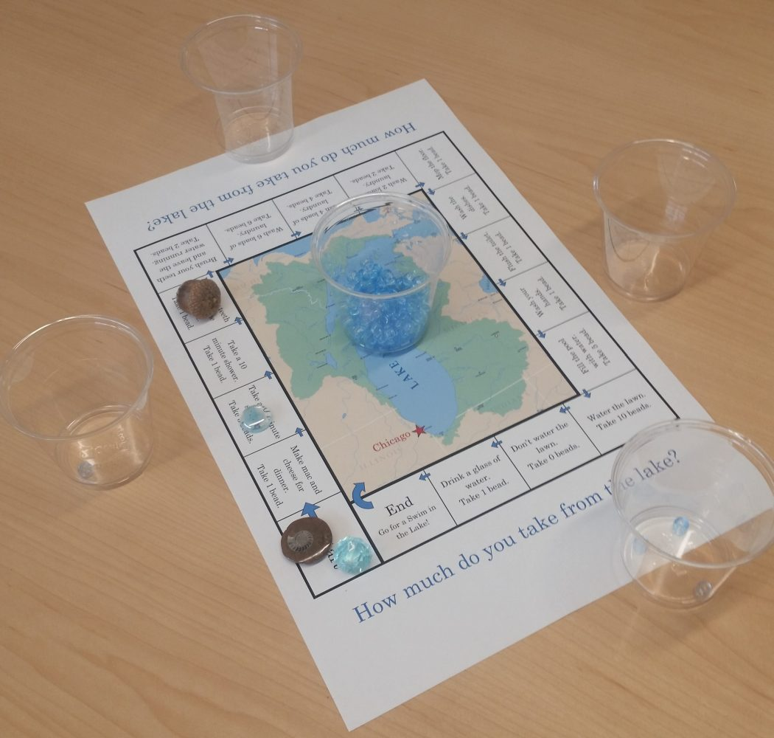
Oyun Tasarımı
Notes:
Scoring: Earning points provides incredible motivation for people. Points show the status of users and users use these points to progress, buy virtual items and win gifts.
Level: Levels are defined as score thresholds. Users can increase their level depending on their participation.
Trophies, medallions: Trophies, badges, ribbons indicate challenges completed and new levels reached.
Challenges: Challenges are based on the tasks that need to be accomplished and the practices that need to be done to achieve success.
Highest score, finish first, finish highest (Races): Users compete with each other to get the highest score in activities. When the activities are over, the user with the highest score receives a prize, while the losers receive a consolation prize.
Virtual items: Virtual items play an important role in self-expression in the environment. They are intangible intangible objects purchased for use in online environments or games. Users can create their own identities by purchasing virtual items such as clothes, weapons, ornaments, and earn real dollars by selling virtual items to users.
Leadership Ranking: In gamification, the leaderboard is used to show those who perform the important behaviors desired by racing.
For the right design, the information used should be internalized and used at the analysis-synthesis level.
Adapting using board games or traditional games is educationally meaningful and useful, but if it is adapted by teachers, it can be defined as an educational game, not a
If a game design is desired to be combined with robotic design, it can be provided with an integration such as receiving commands from the robot within the game. Essentials of digital game design ; While designing the game, it is both learning the subject and using algorithm - programming skills.
Game Development Platforms
https://gdevelop-app.com/
https://urho3d.github.io/
https://www.monogame.net/
https://enigma-dev.org/
http://playir.com/dev/

Slide 24
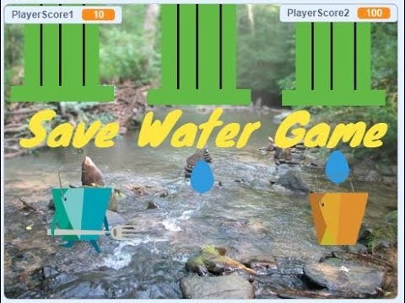
Oyun Tasarımı
Notes:
Scoring: Earning points provides incredible motivation for people. Points show the status of users and users use these points to progress, buy virtual items and win gifts.
Level: Levels are defined as score thresholds. Users can increase their level depending on their participation.
Trophies, medallions: Trophies, badges, ribbons indicate challenges completed and new levels reached.
Challenges: Challenges are based on the tasks that need to be accomplished and the practices that need to be done to achieve success.
Highest score, finish first, finish highest (Races): Users compete with each other to get the highest score in activities. When the activities are over, the user with the highest score receives a prize, while the losers receive a consolation prize.
Virtual items: Virtual items play an important role in self-expression in the environment. They are intangible intangible objects purchased for use in online environments or games. Users can create their own identities by purchasing virtual items such as clothes, weapons, ornaments, and earn real dollars by selling virtual items to users.
Leadership Ranking: In gamification, the leaderboard is used to show those who perform the important behaviors desired by racing.
For the right design, the information used should be internalized and used at the analysis-synthesis level.
Adapting using board games or traditional games is educationally meaningful and useful, but if it is adapted by teachers, it can be defined as an educational game, not a
If a game design is desired to be combined with robotic design, it can be provided with an integration such as receiving commands from the robot within the game. Essentials of digital game design ; While designing the game, it is both learning the subject and using algorithm - programming skills.
Game Development Platforms
https://gdevelop-app.com/
https://urho3d.github.io/
https://www.monogame.net/
https://enigma-dev.org/
http://playir.com/dev/

Slide 25
Sıra Sizde
Probleminizde bulduğunuz alt problemlerden herhangi biri hakkında bir oyun tasarlayın.
Oyun öner
Karakterler
Oyunun Bileşenleri
Ödül
Ceza

Slide 26
Probleminize uygun bir oyun geliştirip padlete yükleme.

Slide 27
Teşekkürler..
.

